Slide 1

Industrial Training Report Presentation
ON
WEB CONTROLLED SURVEILLANCE ROBOT CAR
At
Defence Research Development Organisation, New Delhi
Chahat Segan
17092038
May 2021

Slide 2

About the company
The Defence Research and Development Organisation (DRDO) is an agency under the Department of Defence Research and Development in Ministry of Defence of the Government of India, headquartered in Delhi, India.
It is charged with the military's research and development.
DRDO is India's largest and most diverse research organisation.
It has a network of 52 laboratories, which are engaged in developing defence technologies covering various fields, like aeronautics, armaments, electronics, land combat engineering, life sciences, materials, missiles, and naval systems.

Slide 3
Objective
To build a surveillance robot that uses Raspberry Pi as a microcontroller and transmits live video footage over the internet.
The robot is also programmed to get instructions from a user at a remote location.

Slide 4
introduction
The Robot is a useful and inexpensive security and spy tool, which have many configurable options.
It has a web camera mounted over it, through which we will get live video feed
we can control and move this robot from a web browser over the internet.
As it can be controlled using webpage, means it can also be controlled using Smart phones, laptops, tablets or any similar devices.
The proposed surveillance system requires less storage space as it records the video and captures the images only when the motion is detected in the monitored area.

Slide 5


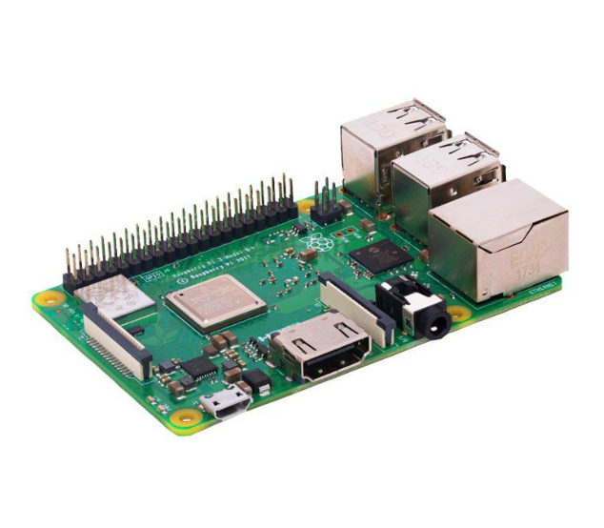
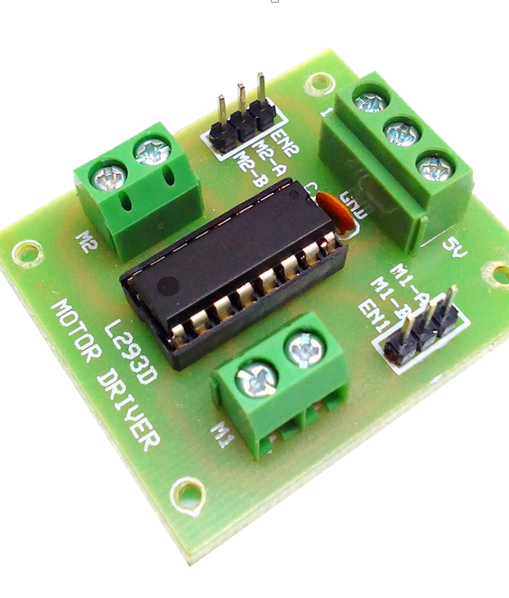
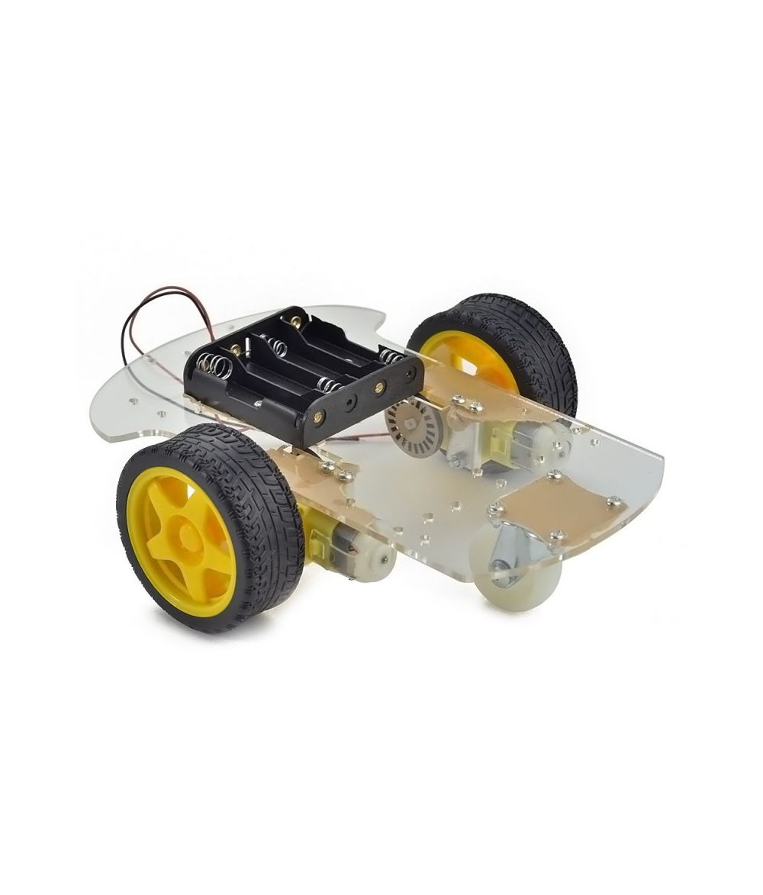
Hardware Required
Raspberry Pi Model 3 B+
USB Connector Cable
L293D Motor Driver
DC Motors
Wooden Chassis
HDMI Cable
Quantum QHM495LM Webcam
Screws and Nuts
Wire Strippers & Screw Drivers
Wheels
Micro SD Card (16 GB)
Batteries

Slide 6
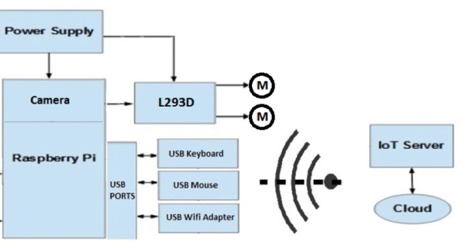
Block diagram

Slide 7
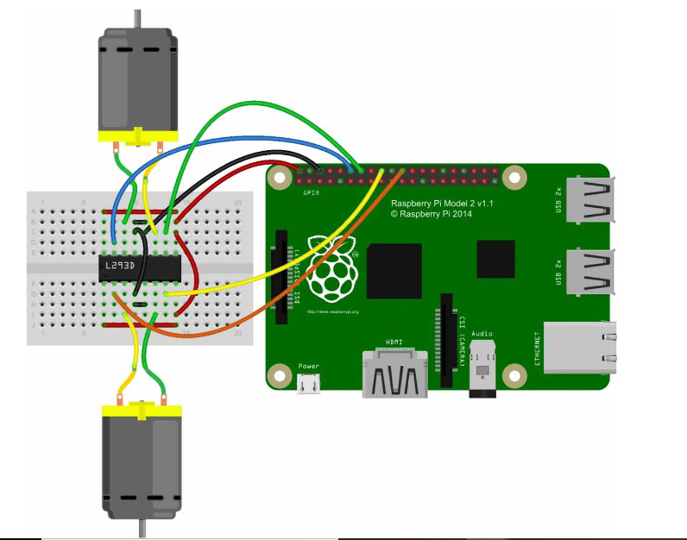
Circuit diagram and connections

Slide 8

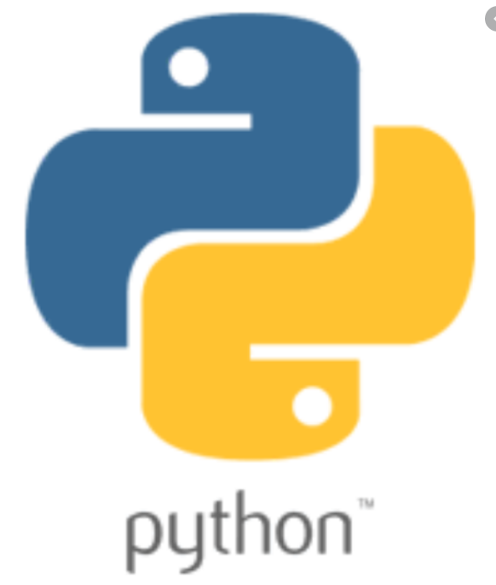


PROGRAMMING LANGUAGES & SOFTWARE REQUIRED

Slide 9
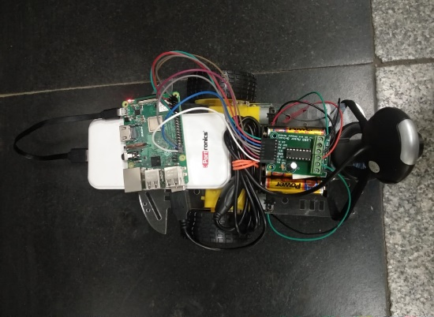
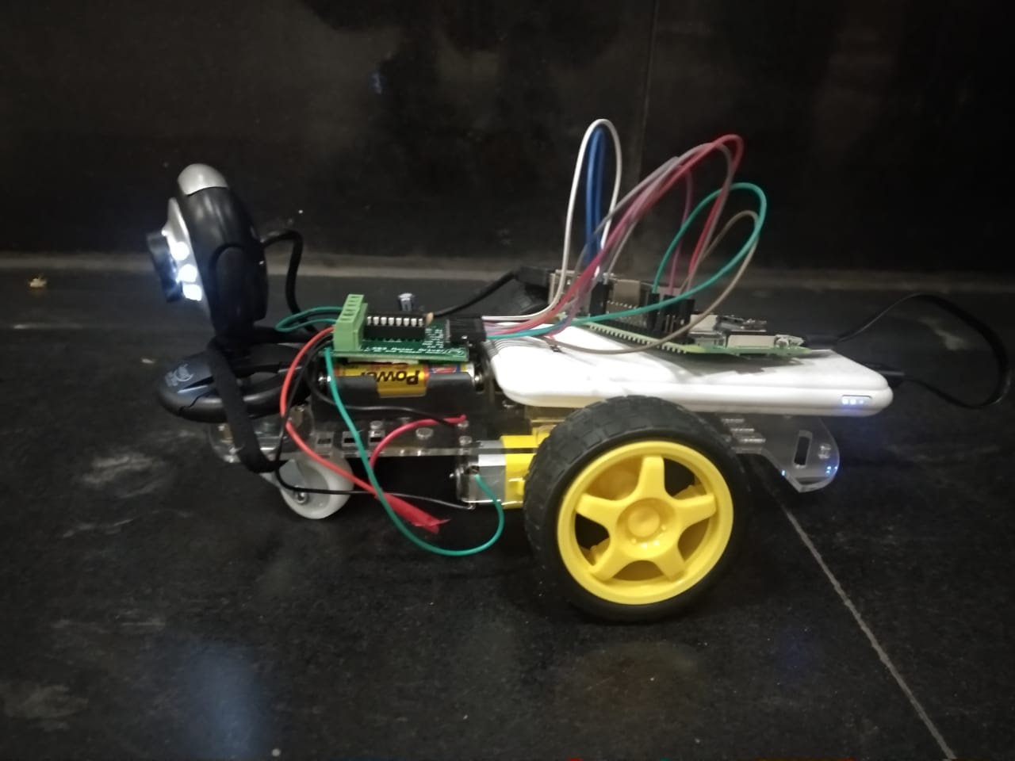
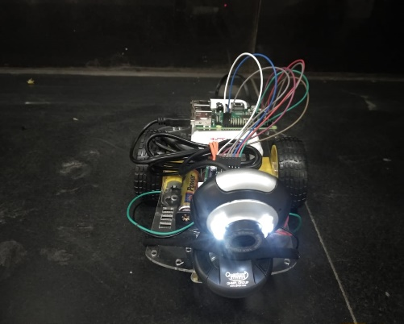
THE ROBOT AFTER ASSEMBLY

Slide 10
WORKING
We use the IP Address linked to the Raspberry Pi to send commands to the robot via the internet
The commands are given via the HTML interface created
After the commands are issued via the HTML page, Flask comes into play by converting the HTML commands to according to Python framework
Flask allows us to run our python scripts through a webpage and we can send & receive data from Raspberry Pi to web browser and vice versa.

Slide 11
WORKING
After processing the commands received the Python program calls forth the corresponding functions to configure the GPIO pins of the Raspberry Pi.
The Python programs configures the GPIOs
These GPIOs control the working of the DC motors which hence control the direction and movement of the wheels of the robot
The camera will project the live feed throughout this process.

Slide 12
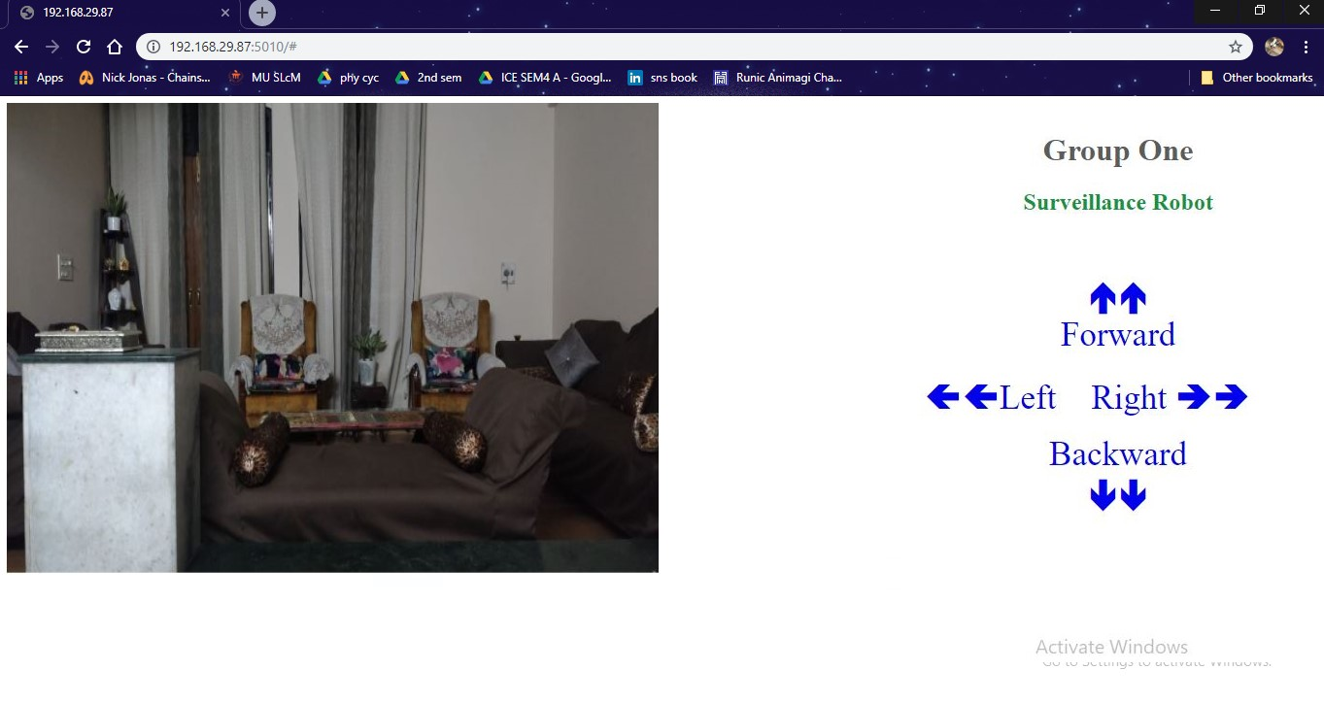
observations

Slide 13
Applications
Our robot car can be used as a security, spy tool on a low budget scale.
It can also be used as a remote-controlled car without mounting the camera on top.
A high budget model of this project can be used in day to day security or surveillance, offices, defence, military etc.

Slide 14
references
http://www.ti.com/lit/ds/symlink/l293.pdf
https://www.raspberrypi.org/help/what-%20is-a-raspberry-pi/
https://www.instructables.com/id/Raspberry-Pi-as-low-cost-HD-surveillance-camera/
https://randomnerdtutorials.com/cctv-raspberry-pi-based-system-storage-motioneyeos/
https://www.itpro.co.uk/hardware/31258/how-to-build-a-raspberry-pi-security-camera
https://randomnerdtutorials.com/install-motioneyeos-on-raspberry-pi-surveillance-camera-system/
https://www.elprocus.com/h-bridge-motor-control-circuit-using-l293d-ic/
https://circuitdigest.com/microcontroller-projects/raspberry-pi-surveillance-camera
https://raspberrypi.stackexchange.com/questions/28234/take-snap-from-raspberry-pi-using-motion
https://electronics.stackexchange.com/questions/296579/how-does-a-dc-motor-drive-control-the-motor
https://www.electricaltechnology.org/2015/11/what-are-dc-drives-types-of-electrical-dc-drives.html

Slide 15
Thank You!

